Slide 1
HOT SEAT

Slide 2
“No taxation without representation”

Slide 3
Independence Day (4th of July)

Slide 4
North

Slide 5
Proclamation of 1763

Slide 6
Which countries were involved in the French and Indian War?

Slide 7
Secondary Source

Slide 8
South

Slide 9
Who won the French and Indian War?

Slide 10
Why is the Declaration of Independence important to our country?

Slide 11
Conflict

Slide 12
Primary Source

Slide 13
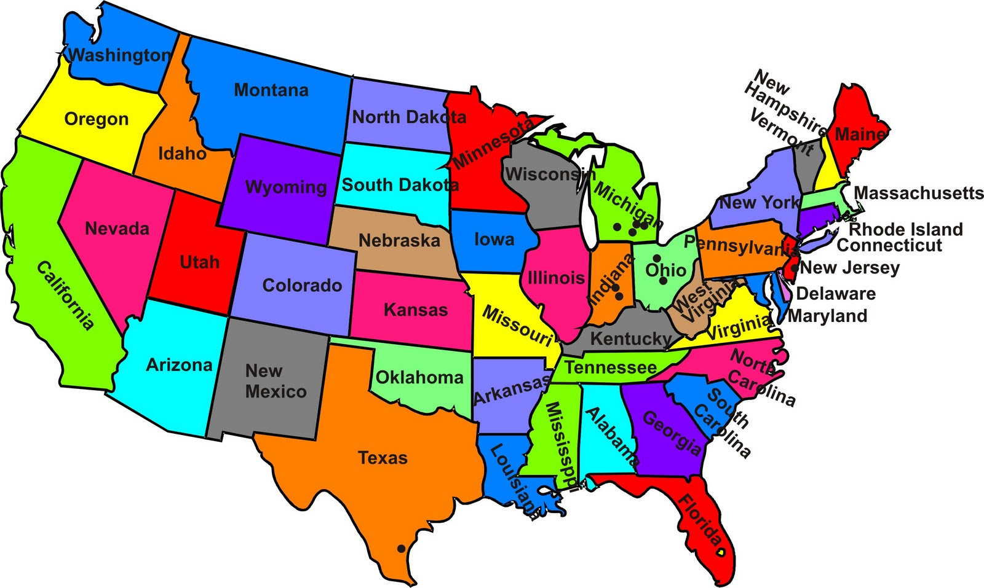
Relative Location

Slide 14
Cooperation

Slide 15
The Constitution

Slide 16
West

Slide 17
Why would the Constitution need to be amended or changed?

Slide 18
Causes of the Revolutionary War

